Slide 1
HAZOP Risk Matrix

Slide 2
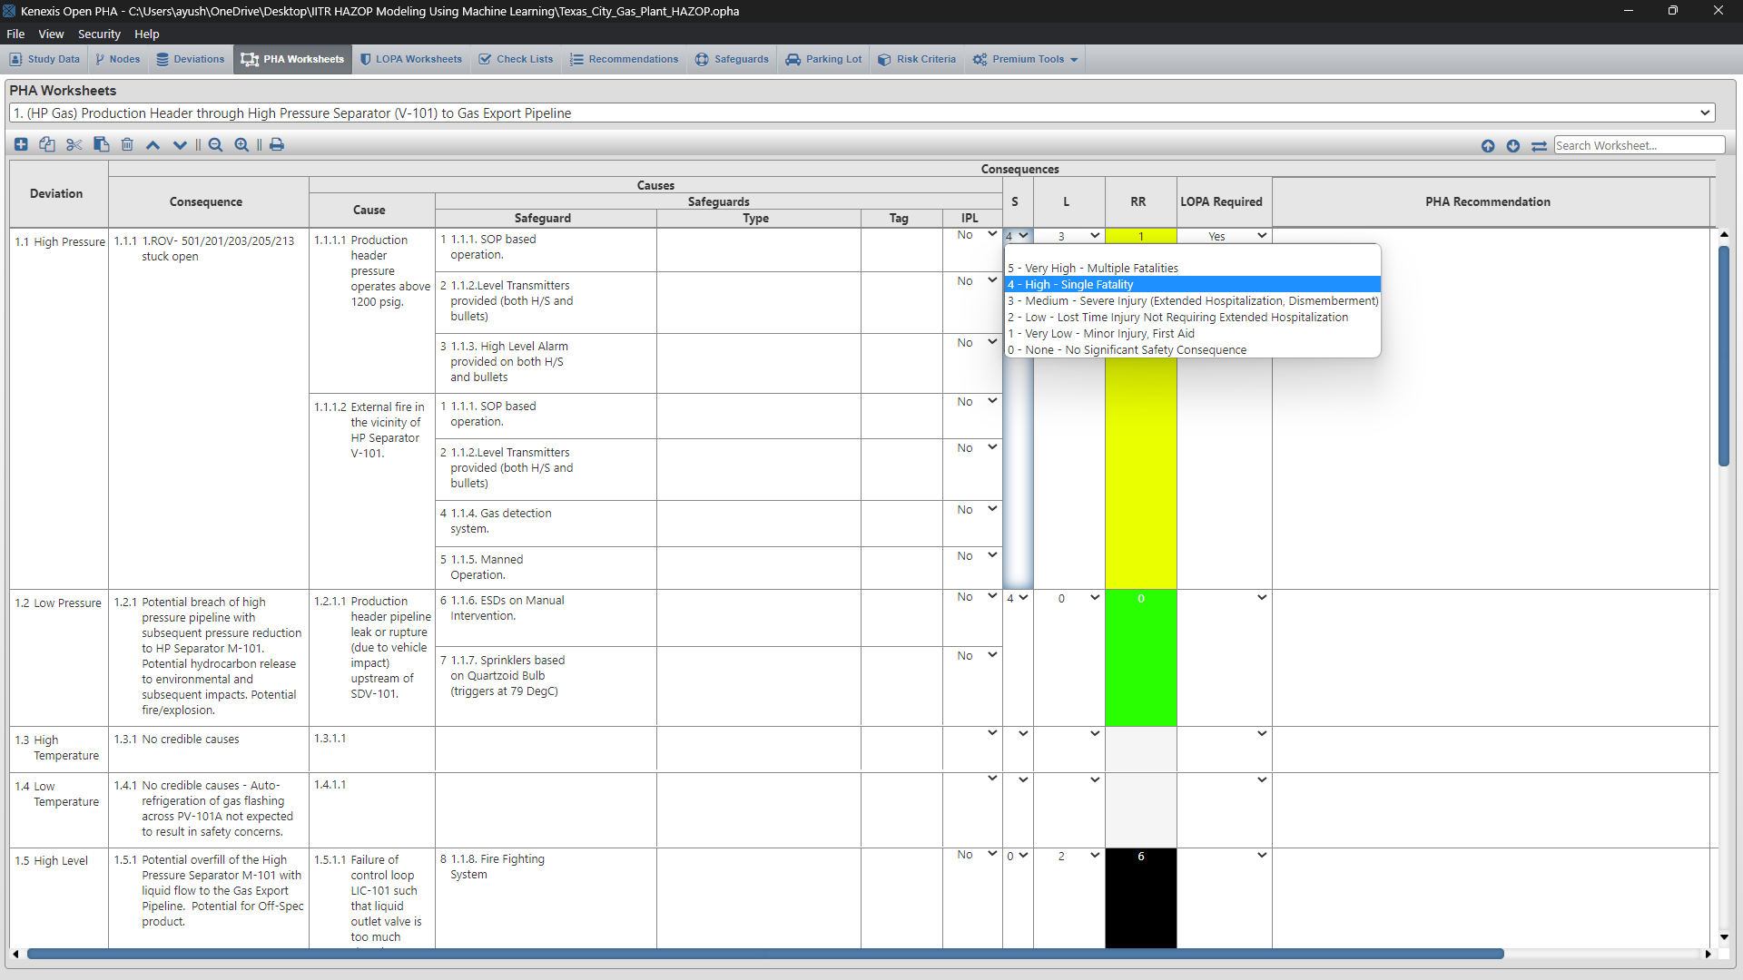
Risk Matrix

Slide 3
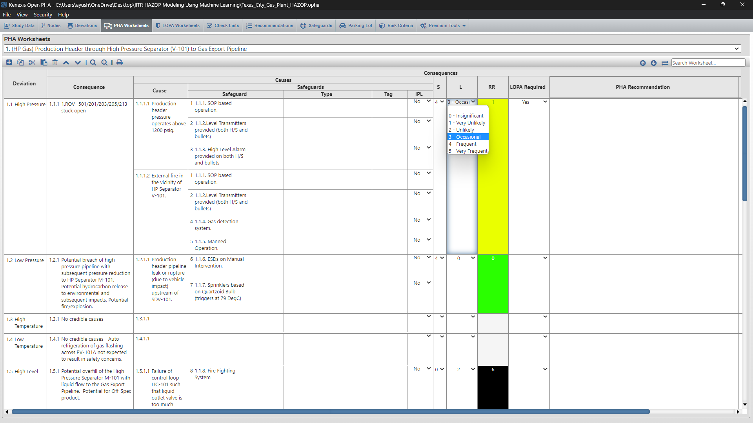
Selection of Servity and Livelihood

Slide 4
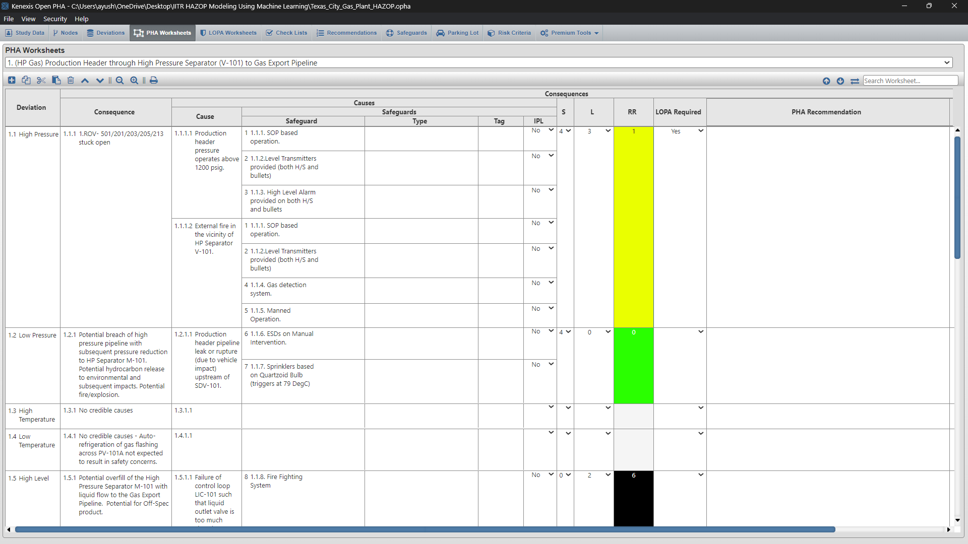

Slide 5
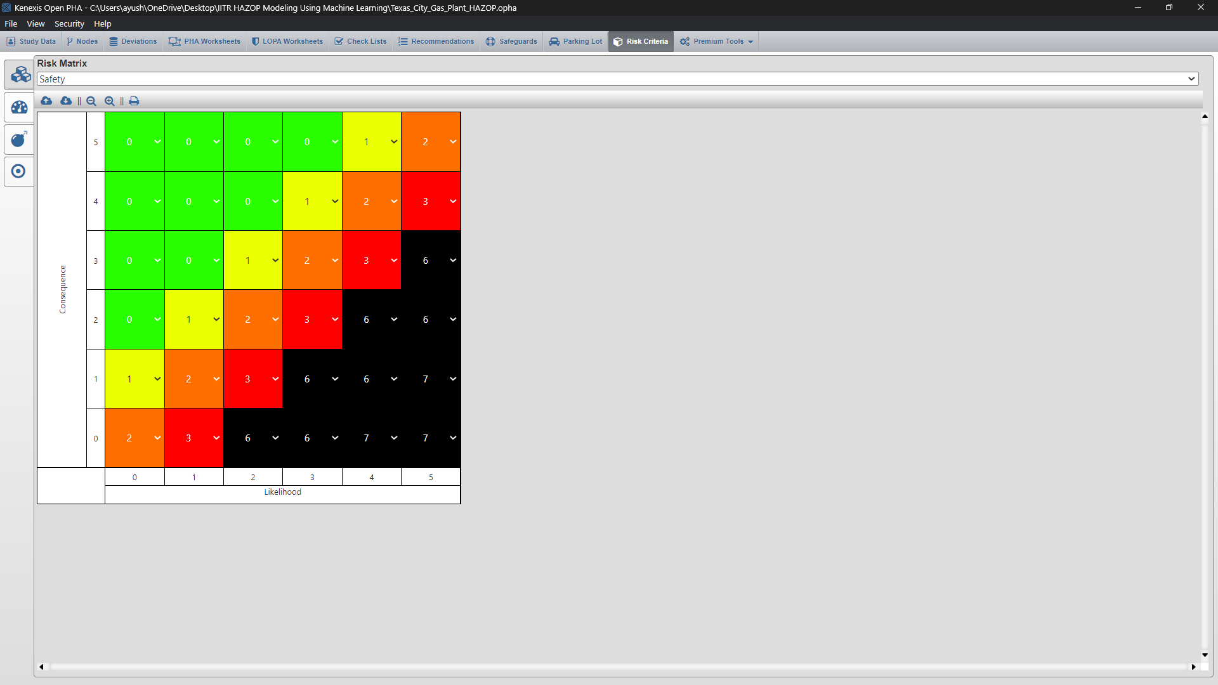

Slide 6
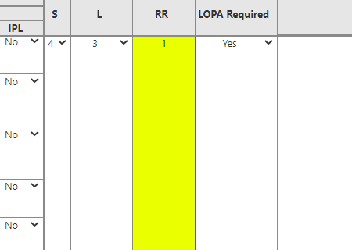
Node1-Deviation 1.1

Slide 7
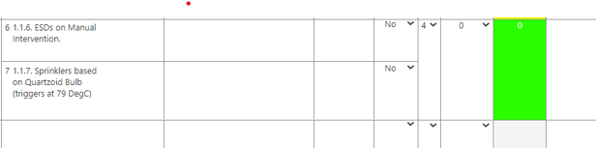
Node1-Deviation 1.2

Slide 8
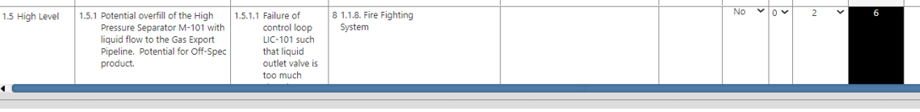

Slide 9
Thank you

